Slide 1
Investigating Booking No-shows
By Shawn D’Souza

Slide 2

A bit about me
Masters of Science in Data Science at NJIT
Currently work at Forbes Media as a BI Analyst
Building out the subscriptions growth analytics domain

Slide 3
A bit about the data
Using an online dataset that highlights the user activity for a Canadian hair salon
11.5% of the total bookings resulted in no-shows
The data categorizes by the current and historical information, highlighting prior visits and most recent information
NOTES: Dataset does not include any personal information on the customers.

Slide 4
Executive summary
To explore trends on the salon, analysis was broken down into:
Background
Key insights
Recommendations and Next Steps
By the end of the analysis, the key takeaways are:
Do encourage clients to rebook in advance if they are scheduled for the mid-week
Do provide more targeted services catered for users
Do prioritize on user feedback during the initial sessions to ensure repeat visits

Slide 5
Agenda
Business Context
Does time of day affect no-shows?
Does service type affect no-shows?
Does having prior sessions affect no-shows?
Takeaways
Recommendations
How does this analysis help your company?
Appendix

Slide 6
Business case
According to a Forbes article, the beauty industry is a $570 billion annual industry
With the rise of personalized care, this makes booking salon appointments vital.
However, no-shows will affect both customers and staff.
This analysis investigates the reasons behind no-shows and highlight key recommendations.

Slide 7
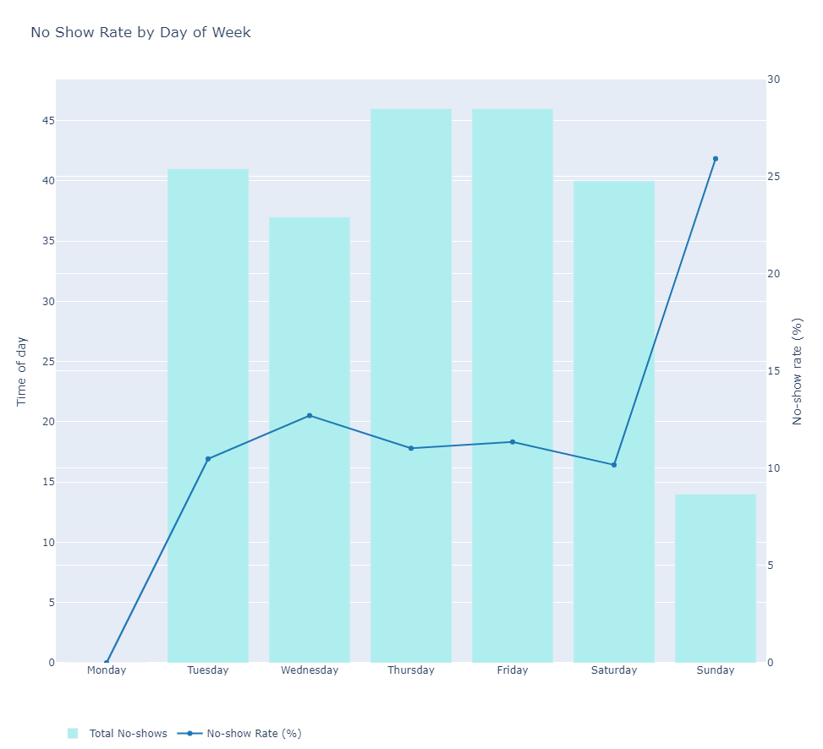
Does the Day of the week affect no-shows?
While Sunday has the highest rate of no-shows, the salon accepted very few visitors (3% of the total sessions booked).
Thursday and Friday was the highest rate of consistent no-shows (Accounting for mid-week cancellations).

Slide 8
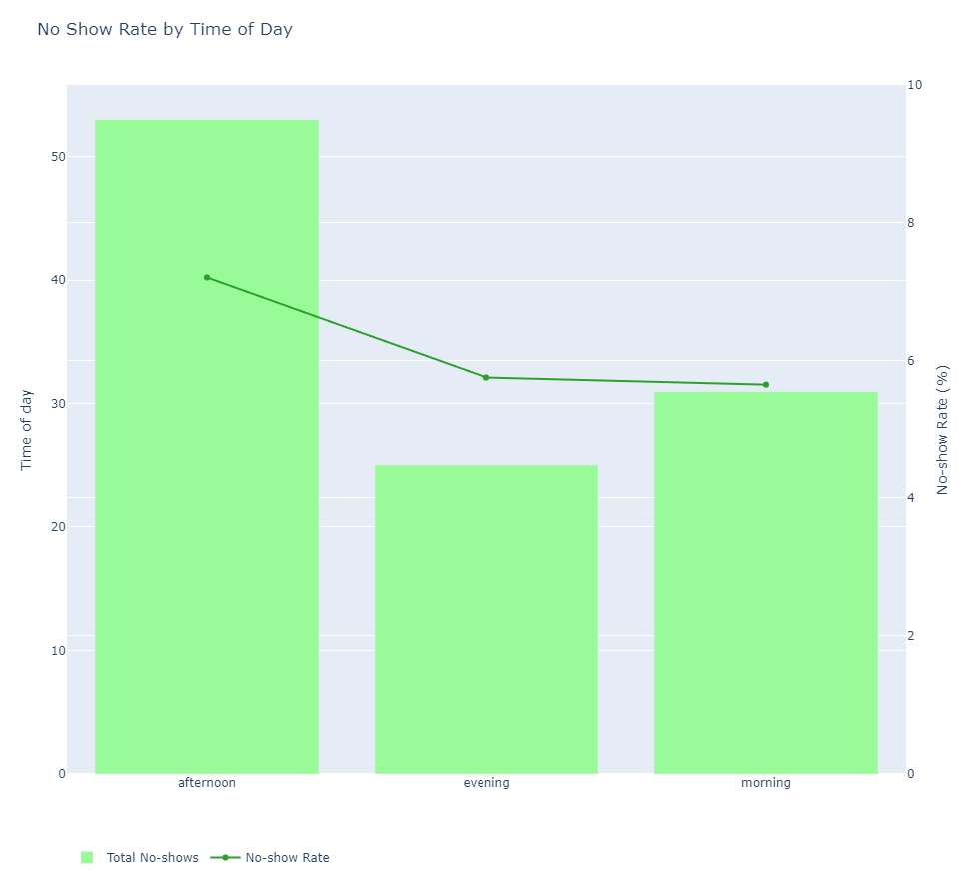
Does the time of the day affect no-shows?
Afternoons were the highest cancellations and cancellation rates
Users are more likely to cancel their bookings if they have other priorities earlier or later during the day

Slide 9
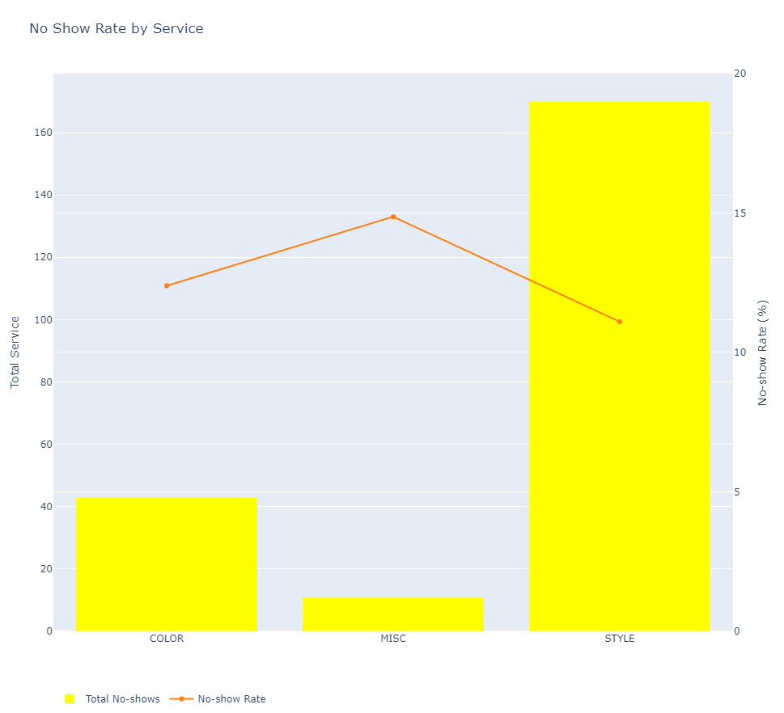
Does Service type affect no-shows?
Miscellaneous services have the highest level of no-shows, and also the least sought-after (4% of the total reservations)
It is recommended to drop this category for more effort on targeted services.

Slide 10
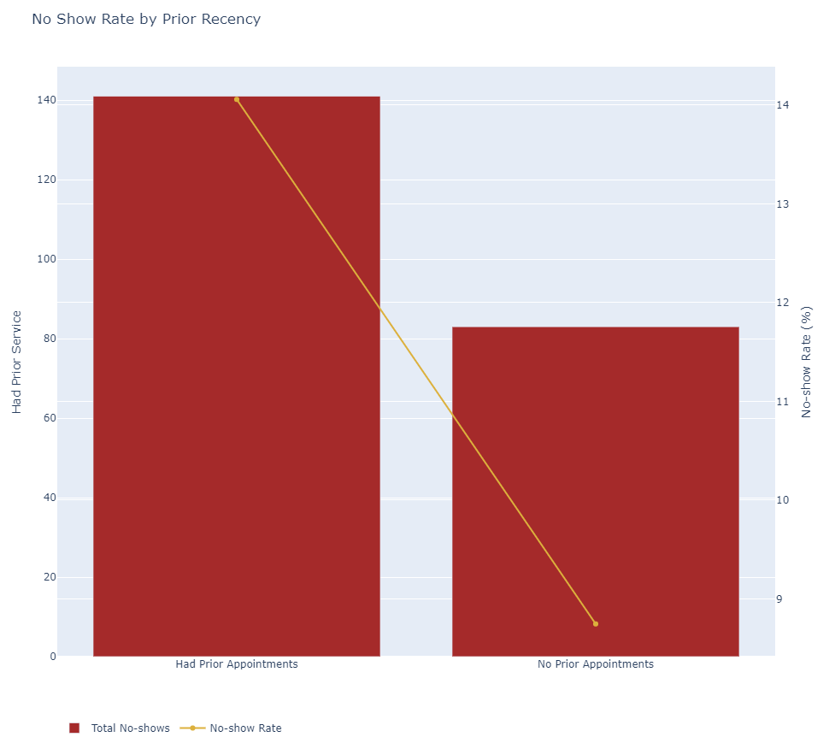
Does having a prior session affect no-shows?
More users skipped their appointments if they had a prior appointment.
This may be attributed to the quality of service that they previously received.

Slide 11
Takeaways
Mid-week services tend to have the most no-shows
Clients are more likely to select established services
Emphasis should be provided to clients during their sessions to promote retention.

Slide 12
Recommendations
Do encourage clients to rebook in advance if they are scheduled for the mid-week or in the afternoon
Do provide more targeted services catered for users
Do prioritize on user feedback during the initial sessions to ensure repeat visits

Slide 13
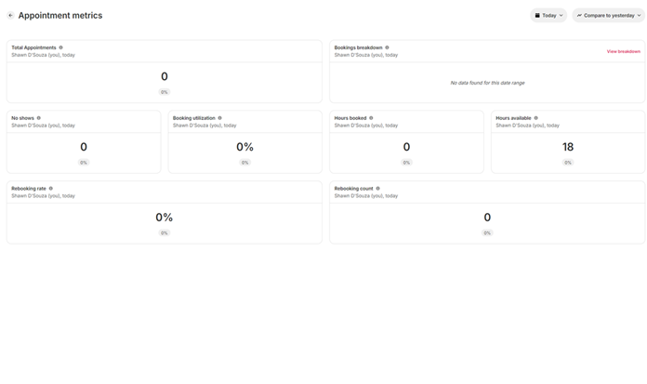
How does this analysis help Your company?
The impact on appointments is just one part of the entire ecosystem within the company.
I am interested in building out the growth analytics domain, from end-to-end website tracking to subscription LTV recommendations and more.

Slide 14
Feel free to reach out
Happy to talk more about my skillsets at LinkedIn

Slide 15
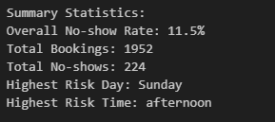
Appendix

Slide 16
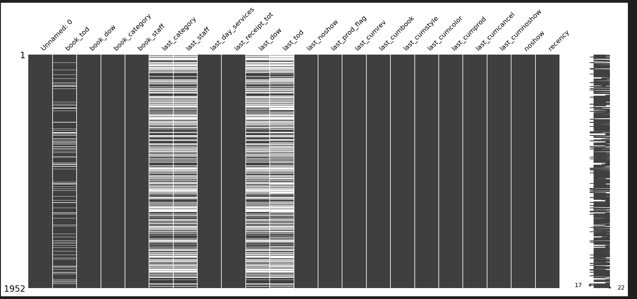
Missing information

Slide 17
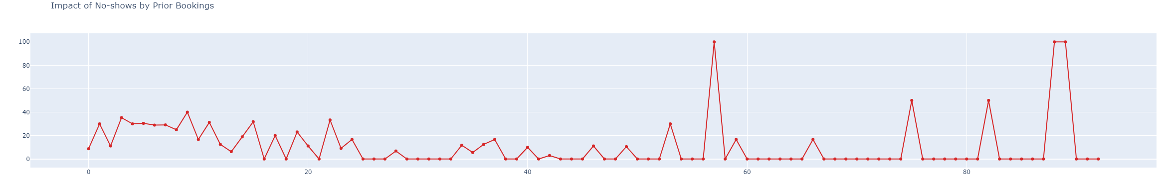
No Shows by Prior booking Rates

Slide 18
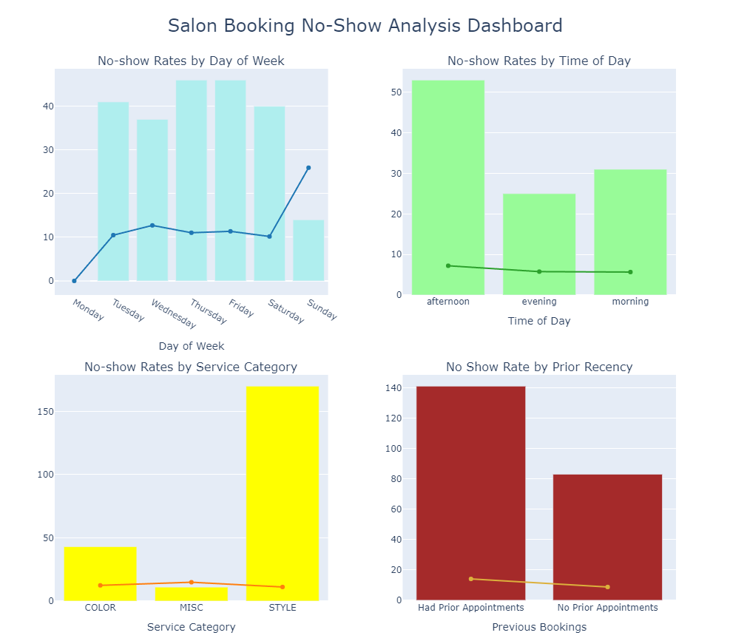
Combined analysis

Slide 19
Thank you

